Slide 1
Final Presentation of Specific Theme Study
Cyclist Safety Aide Using Computer Vision to Identify Bike Obstacles
Student: Lingzhi_Andy_Xie (20015)
Supervisor: Prof. Okuda
August 16th, 2022

Slide 2
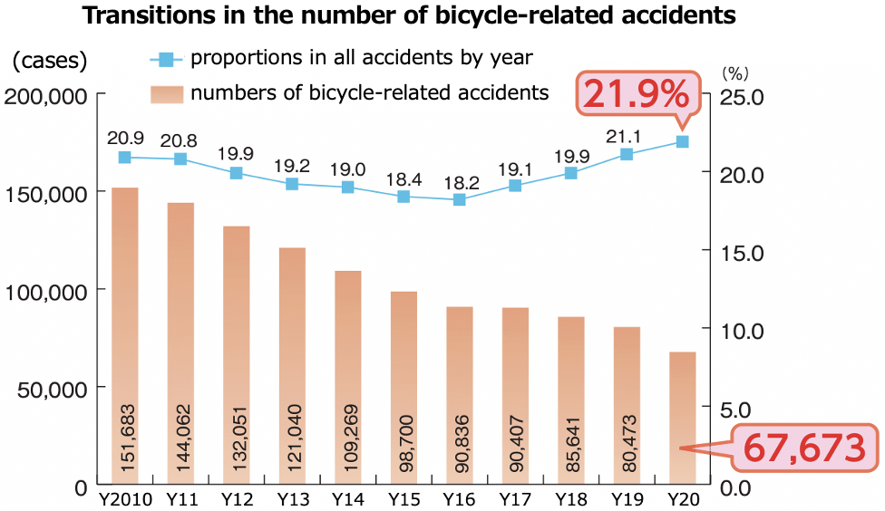
Research Background of Social Issue
Bike accident rate takes high in Japan
Everyday about 200 traffic accidents involve bicycles on average, according to the statistic data from the Traffic Bureau of National Police Agency of Japan.
In many bicycle accidents, victimized cyclists were found not having taken correct contigentcy reaction in time.
Mental issues like fatigue, drug-use, drunkenness etc.
Not always abiding by traffic rules strictly
Bicycle accidents caused by cyclists
Being not aware of inconspicuous poles, curbs, ditches, etc.
Neglecting risks from rear overtaking vehicles
Others …
Research perspective
Only analyzed the bicycle accidents caused by cyclists themselves, and further focused on the problem of being not aware of inconspicuous poles, curbs, ditches, etc. as target problem.

Slide 3
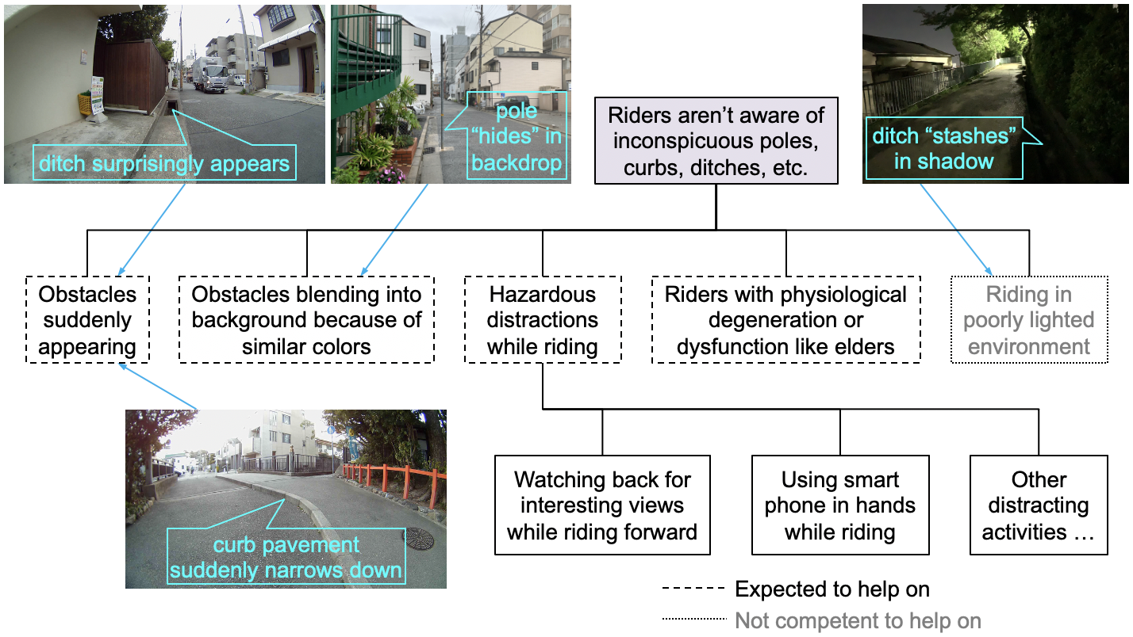
Problem Tree of Target Problem

Slide 4
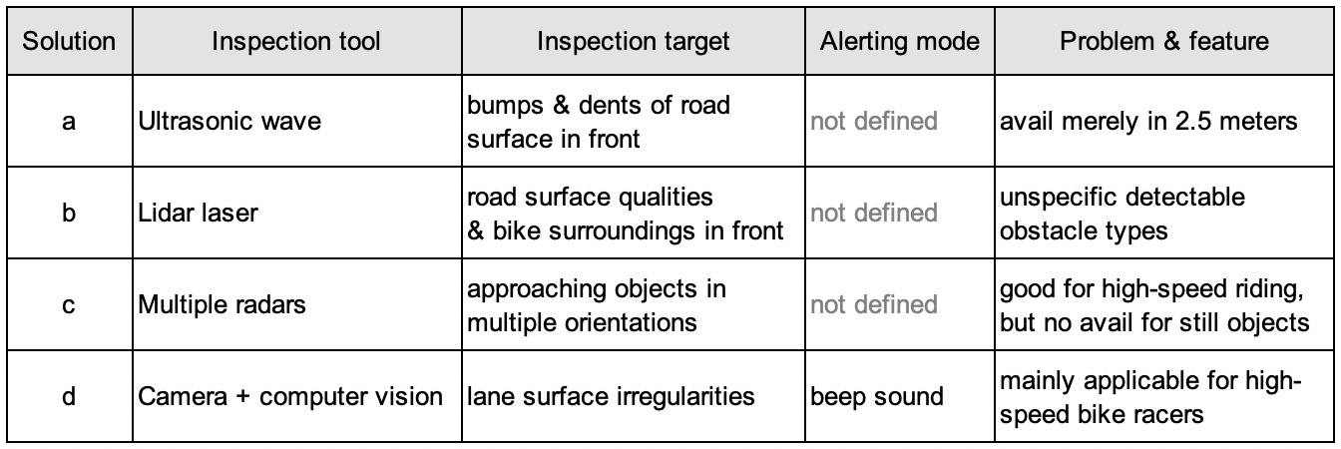
Features and Problems of Existing Solutions
The incentive of a new solution
Solutions a & b have problems of low avail and unclear detectable obstacle types.
Solutions c & d are good for high-speed bike racers, but much less applicable for common riders.
Voice reminding like beeping is a good alerting mode, however, a much better idea is to employ short speech alerts indicating specific obstacle types and rough obstacle orientations.

Slide 5
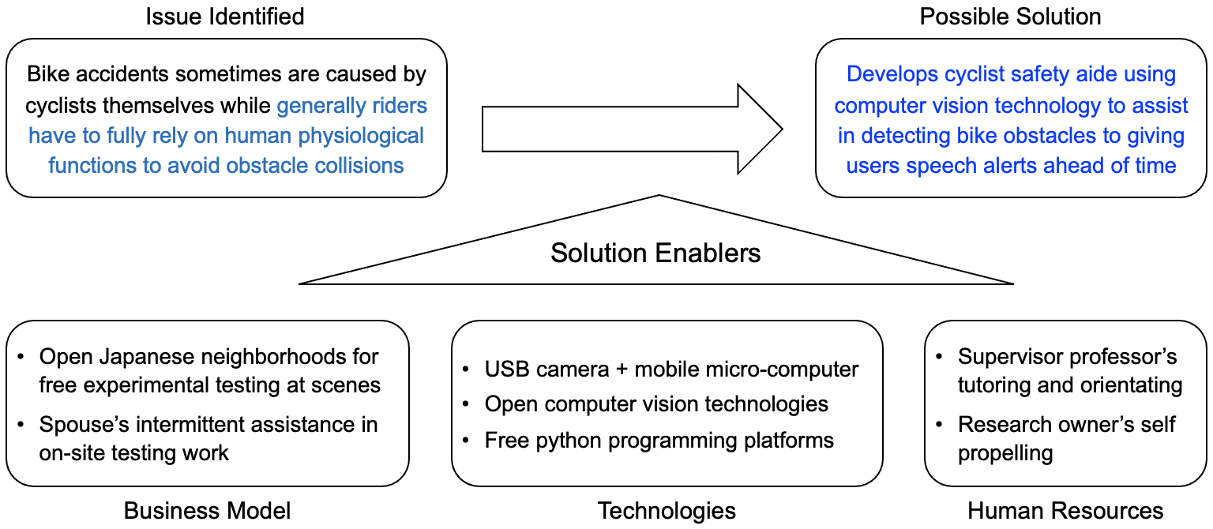
Tankyu Chart of Research Orientation
The possible solution was expected to focus on recognizing obstacles’ types and dangerous levels in order to urge cyclists to make self-protective reactions

Slide 6
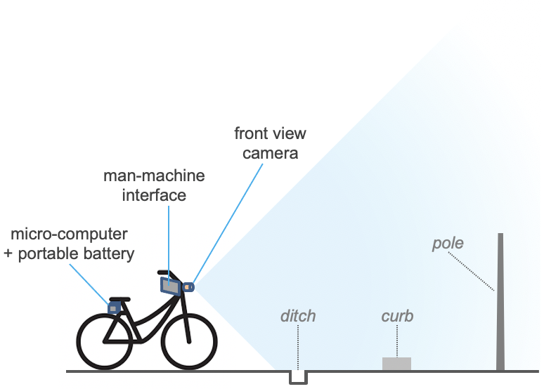
Proposed New Solution
4 hardware constituents
front view camera
man-machine interface
mobile microcomputer
speech broadcaster
4 function constituents
consecutive image capturing by fps in real time & in field
deep neural net of computer vision for obstacle detection
risk level assessment for each detected obstacle
speech alerting message generation
obstacles recognition by CV
risk weights quantitative estimation
speech alert messaging
Pole + Curb + Ditch …
Risk obstacle’s type & orientation
risky obstacles
threshold
riskless obstacles

Slide 7
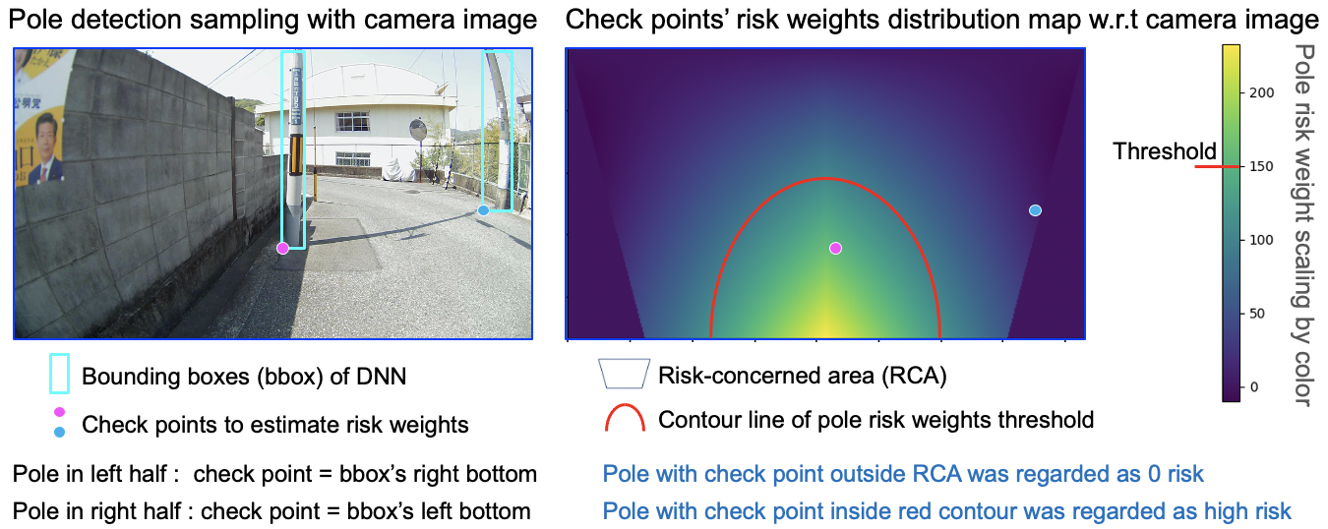
Methodology of Risk Weights Estimation

Slide 8
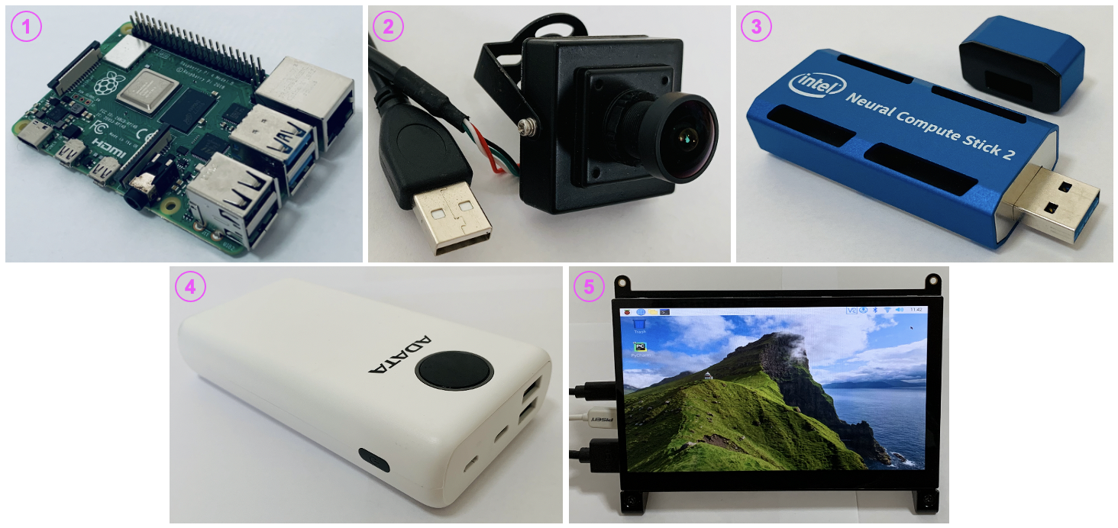
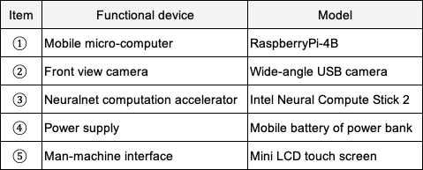
Hardware Components to Develop Prototype
Selection basis
RaspberryPi-4B provides extensive support for external devices and software programming tools.
Without neuralnet accelerator, prototype would fail for slow response speed.

Slide 9
Software Process Flow Chart
Start
Calculate detected obstacles’ risk weights
the running speed of task loop determines the whole performance of prototype
System initialization
Compare risk weights with threshold to judge necessity to alarm
lower risk
Capture images by camera in real time
higher risk
DNN detects obstacles in sampled image
Trigger speech alert

Slide 10
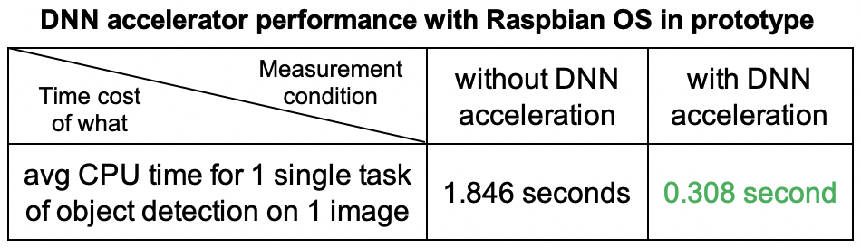
Yolo3-tiny DNN Training and Performance
DNN model training
Totally 800 camera raw pictures were picked out for training.
3 main object classes of pole, curb, and ditch including 9 object sub-classes were adopted for raw picture vott labeling.
Poles’ successful recognition rate achieved about 70~80% which was the highest successful object-detection rate amid all main object classes.
DNN acceleration confirmation
Camera image sampling delay = 0.133 second by default (30 fps & sampling rate 1/4)
With DNN acceleration, 1 detection task consumed 0.133 + 0.308 = 0.441 second
Assuming safety clearance = 7 meters, average cycling speed = 15km/h, then about 7m/(15km/h) - 0.441s = 1.239 seconds was left for cyclist to react to detected danger.

Slide 11
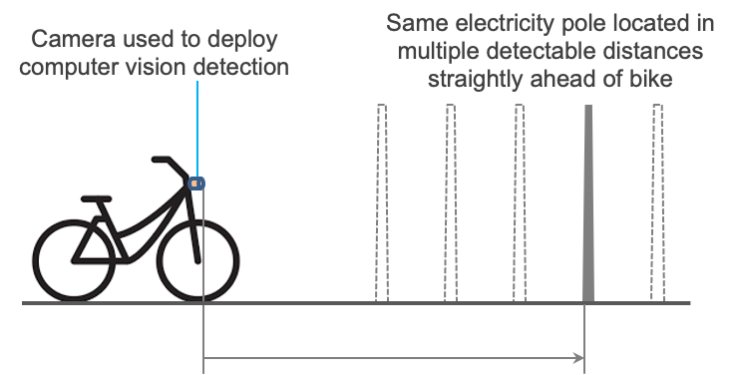
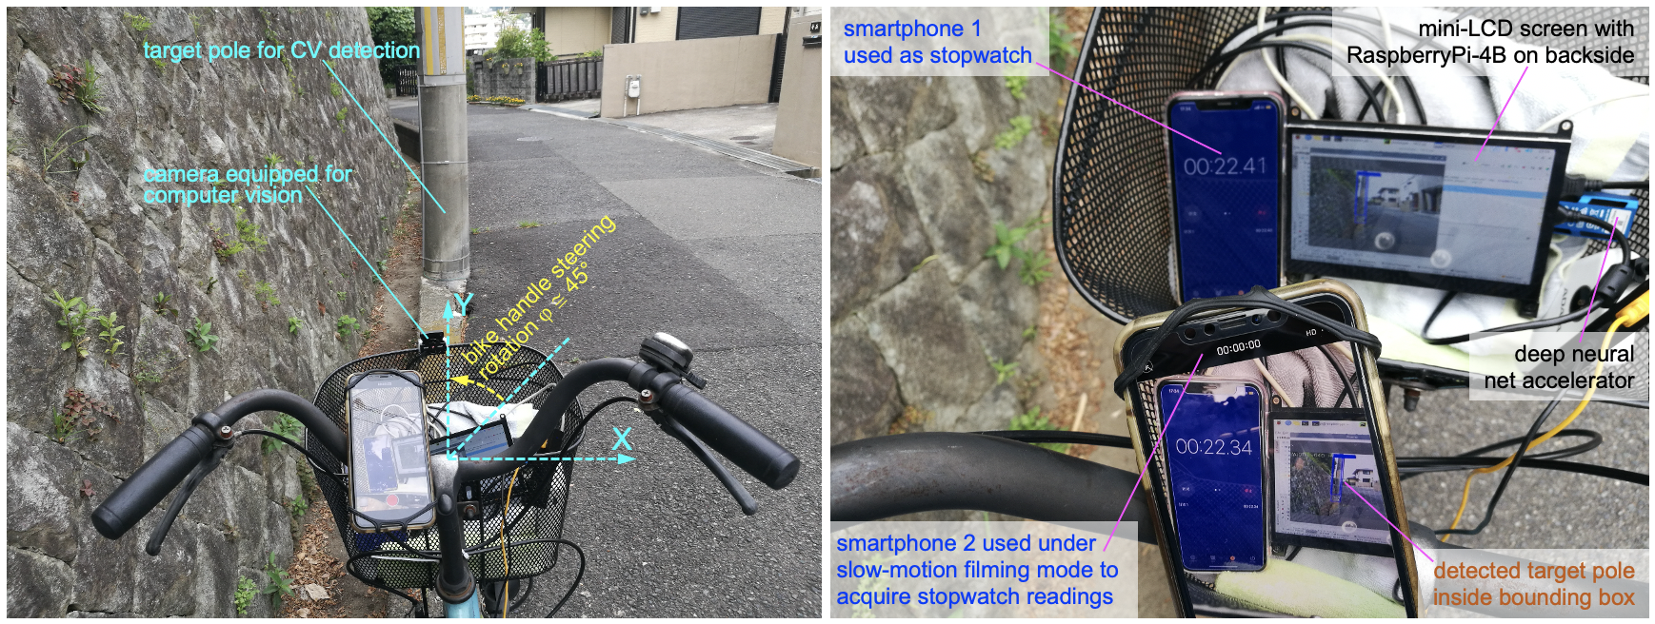
Response Speed Evaluation by Steering Rotation Tests
Test conditions and methods

Slide 12
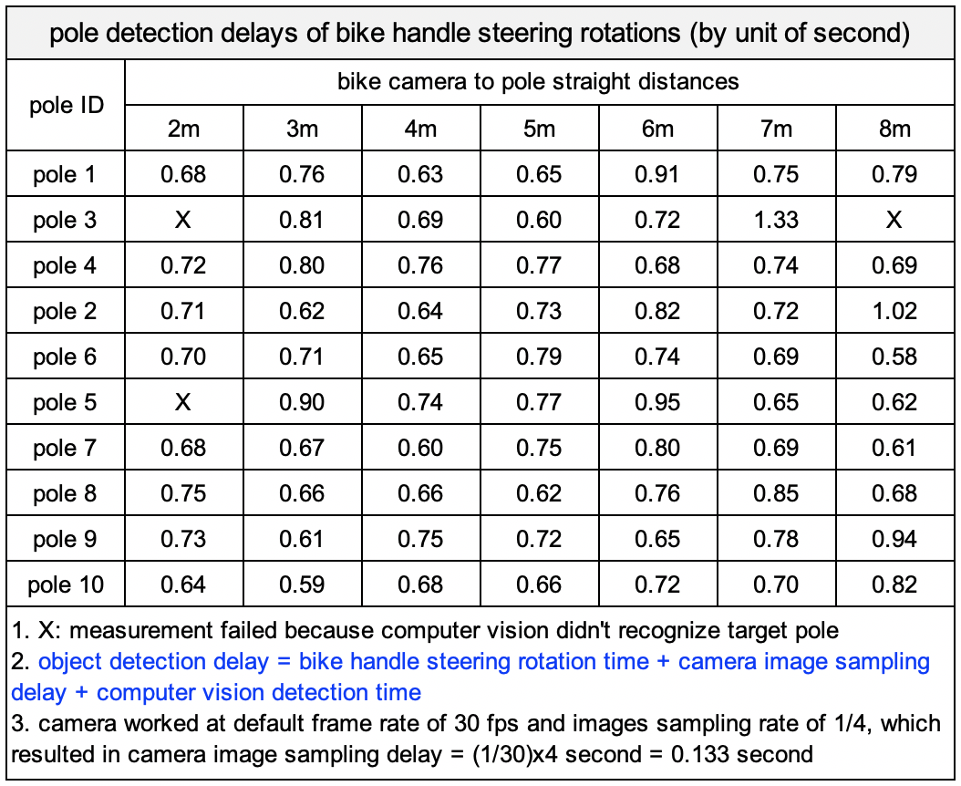
Response Speed Evaluation by Steering Rotation Tests
Successful testing result
Most of pole detection delays in range of 0.6 ~ 0.8 second .
Assuming safety clearance = 7 meters, riding speed = 10km/h in turning, then cyclist got 1.72 ~ 1.92 second for obstacle avoidance, which was sufficient for contingency reaction.

Slide 13
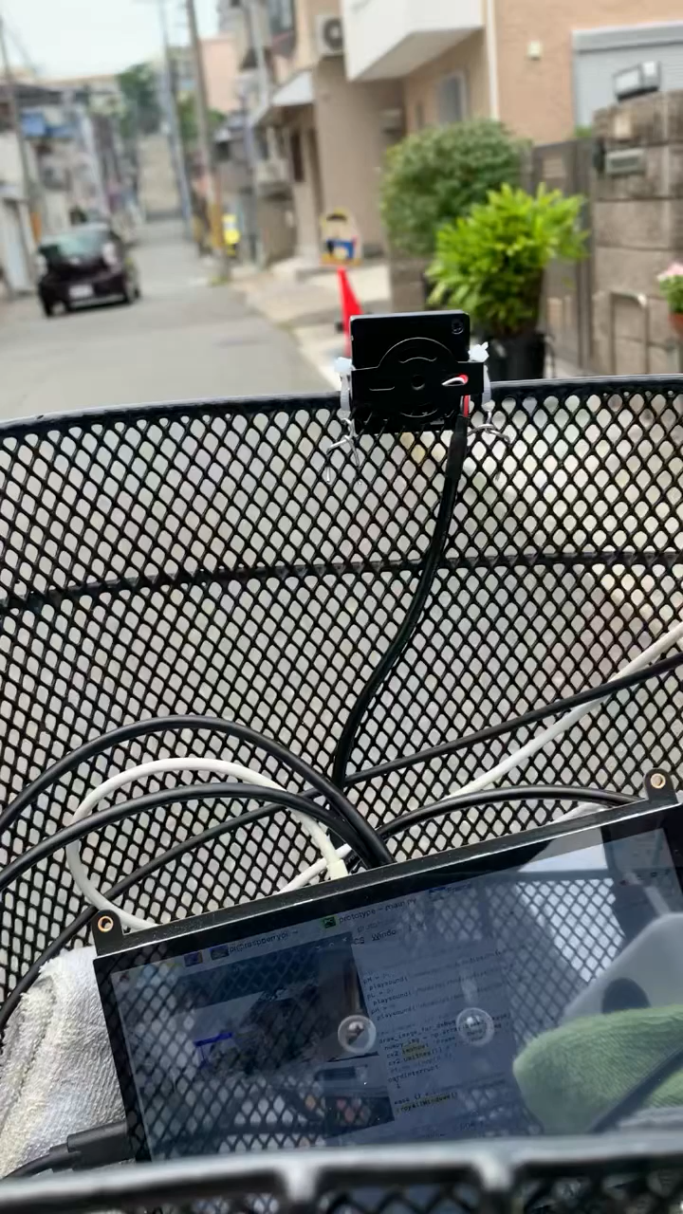
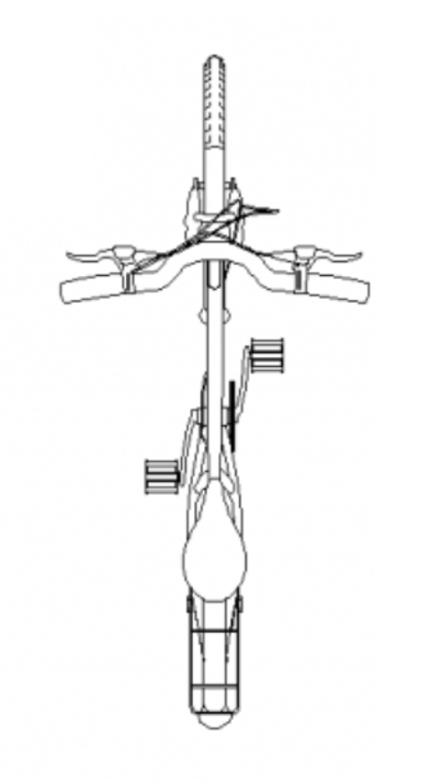
Final Speech Alert Experiment
Video of speech alert test in riding
dismissed
pole middle
pole right
pole left
camera image
prototype camera
Experiment conclusion
Speech alerts were output according to the preset rules with fast response speed

Slide 14
Simple Conclusion
Achievement
The proposal of using deep neural net of computer vision to identify bike obstacles for helping on cycling safety was feasible overall.
Shortcomings to be improved
Use 3000 pictures instead of pervious 800 pics for DNN training to improve prototype’s object recognition success rates for multiple object classes.

Slide 15


読んでくれてありがとう
the End
S20015 Lingzhi-Andy-Xie

